Slide 1


Slide 2
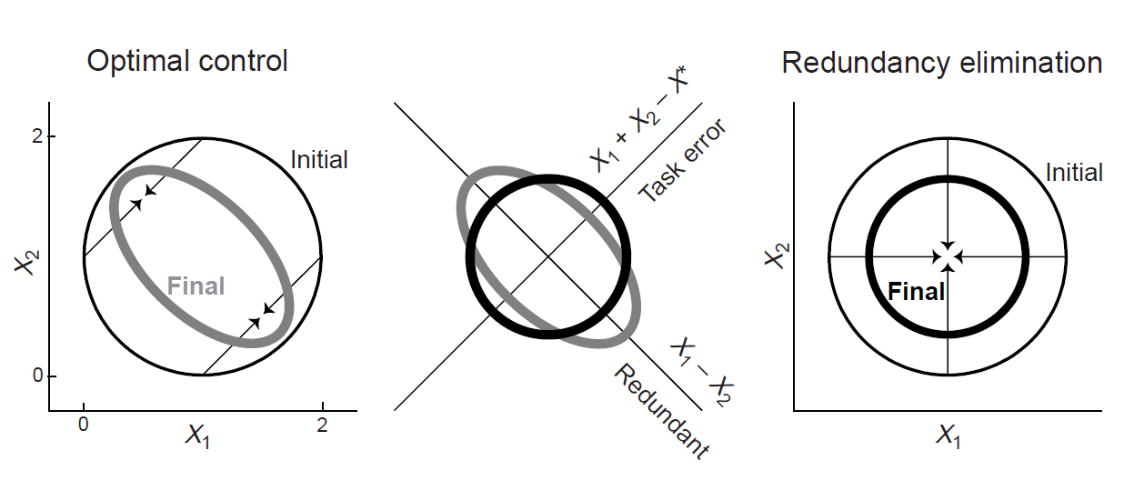
Optimal feedback control
Task-specific adaptations to perturbation and uncertainty
Todorov & Jordan 2002 Nature Neurosci

Slide 3
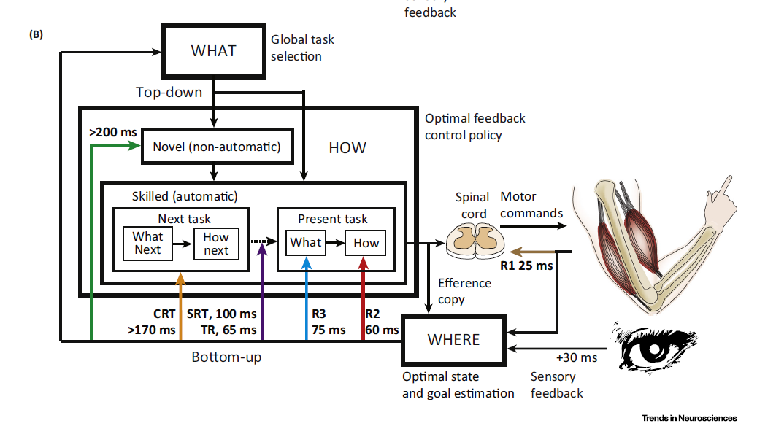
Hierarchy of motor control phenomena
Short-latency
Long-latency
Scott 2016 Trends in Neurosci

Slide 4
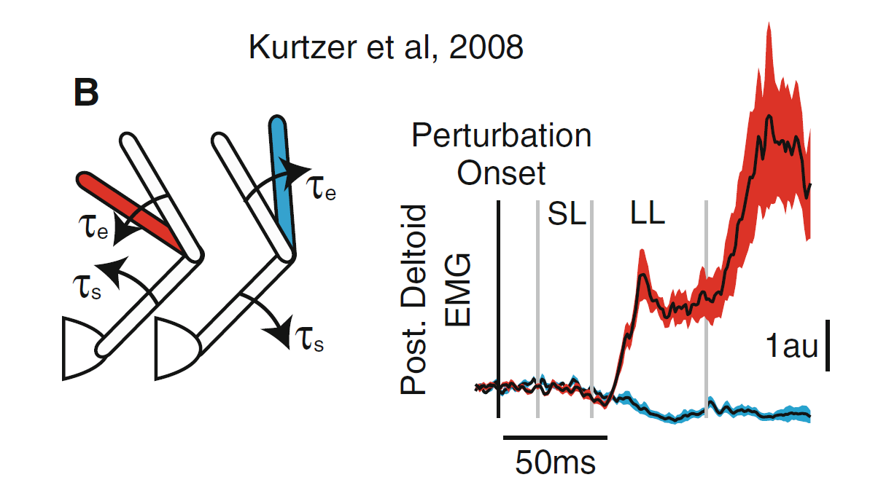
Short-latency: muscle-restricted
Kurtzer et al 2008 Curr Biol

Slide 5
Long-latency: higher-level
Kurtzer et al 2008 Curr Biol
Notes:
There’s some motor cortex stuff that supports its role in this:
Most recently, a confusing Omrani paper that just shows contextual modulation of M1 and PM activity where you don’t in S1 or PPC, and non-specific “is engaged” modulation in PPC and M1 that is not visible in S1.
There’s older stuff from Cheney & Fetz and Evarts & Tanji that show two different latencies of activity in M1 to mechanical perturbations, showing evidence for different volleys of activity that align with those seen in the EMG in response to perturbation.

Slide 6
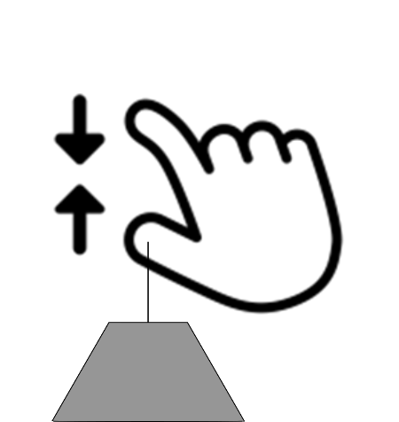
Does this hold further distal?
kinematics
EMG
FDS (D2-5 flexor)
unloaded
FPL (thumb flexor)
loaded
Load onset
Cole et al 1984 Exp Br Res.

Slide 7
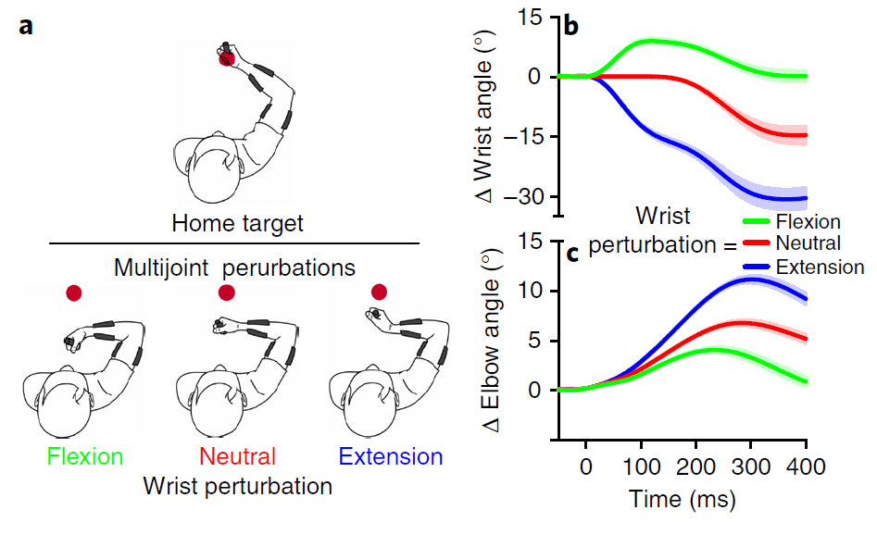
Experiment
“Maintain position”
Engage Wr Ext
Engage Elb Ext
Flexion
Flexion
Flexion
Flexion
Notes:
Up = flexion
Down = extension

Slide 8
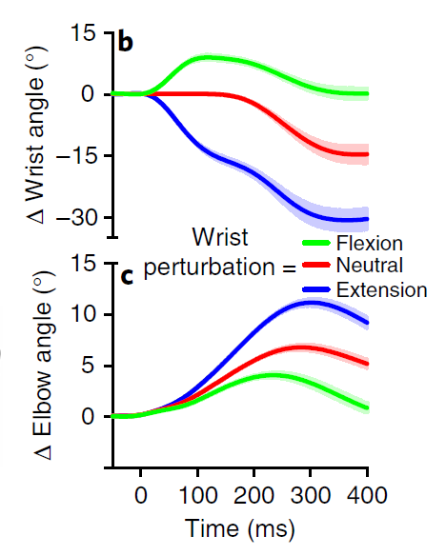
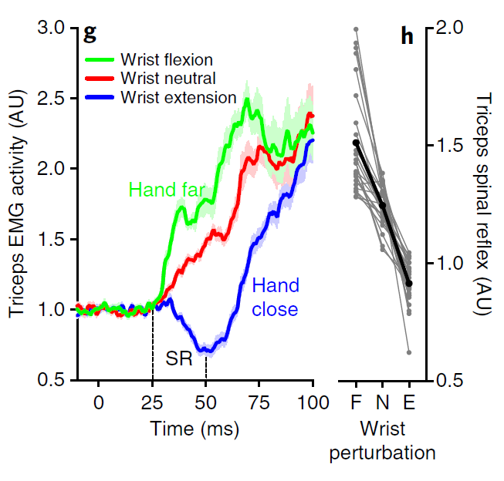
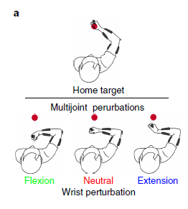
Result: fast reflex is tuned to goal, not muscle
Flexion
Flexion

Slide 9
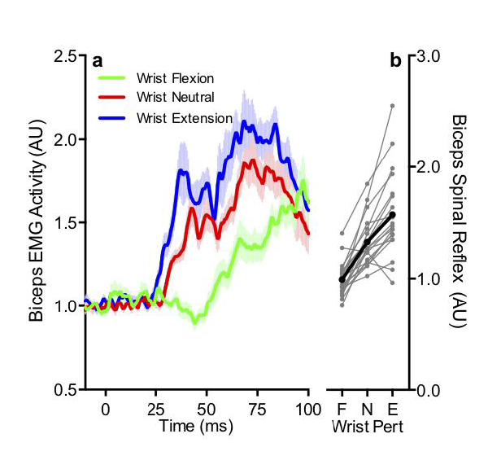
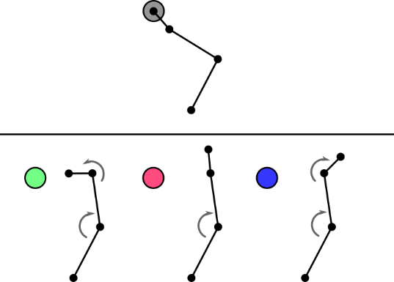
Flexor reflex follows similar rules
Engage Wr Flex
Engage Elb Flex
Extension
Extension

Slide 10
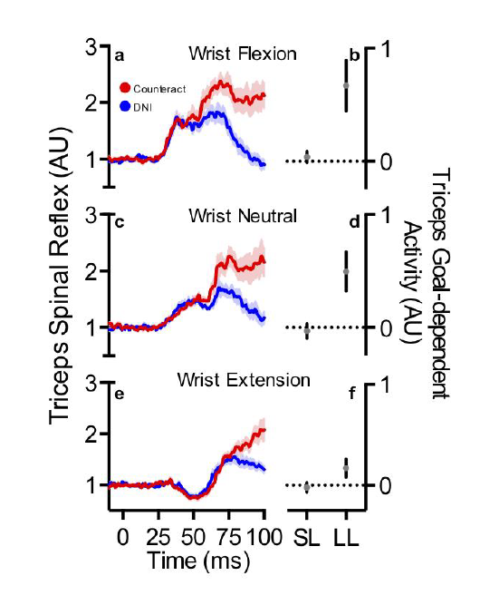
Goal modulation at the periphery? Another experiment:
“Don’t react”
Engage Wr Ext
Engage Elb Ext
Maintain
Don’t react
Flexion
Flexion

Slide 11
Testing for dependence on spindle sensitivity
Engage Wr Flex
Engage Elb Ext
Flexion
Extension

Slide 12
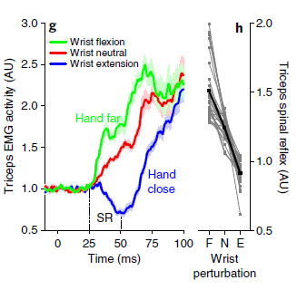
Spindle sensitivity seems to dictate reflex tuning
(Putatively)
De-sensitized wrist extensor spindles
(applied extension load)
(Putatively)
Hyper-sensitized wrist extensor spindles
(applied flexion load)
Normal sensitivity
(no applied load)

Slide 13
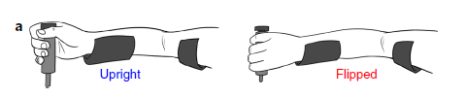
Wait: is this hard-wired to specific muscles?

Slide 14
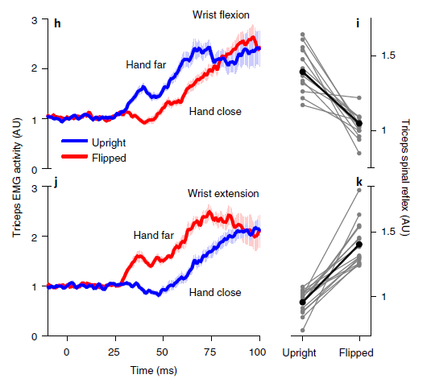
Reflex re-maps for different arm orientations

Slide 15
Conclusions
Spinal reflexes seem to act in extrinsic space in the distal upper limb
This contrasts with what is seen in the proximal limb
This result may hold for reflexive digit movements?
Spinal reflexes: more sophisticated than we thought?
Spinal reflexes: most sophisticated for hands than shoulders?

